Slide 1

Capstone Project
Face Emotion Recognition
Team Members
Babu Shafil

Slide 2

Content
Project Introduction
Problem Statements
Data Summary
Exploratory Data Analysis
Model Formulation
Accuracy & Performance
Deployment
Challenges
Summary

Slide 3
Project Introduction
Live Class Monitoring System using Real time face recognition
Facial Recognition is a technology which uses biometric markers to detect emotions in human faces
The Architecture: we use of a convolutional neural network for the image recognition task instead of regular machine learning techniques such as Decision Tree or Gradient Boosting
Applications of facial recognition

Slide 4
Problem statement
In this digital learning Classes, One of many challenges is how to ensure quality learning for students. Digital platforms might overpower physical classrooms in terms of content quality but when it comes to understanding whether students are able to grasp the content in a live class scenario is yet an open-end challenge.
Final objective in this project is to train a deep learning model which can detect the emotion of face

Slide 5
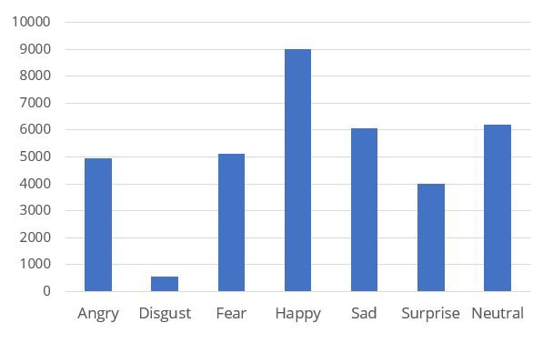
Data Summary
This dataset consists of 35887 grayscale,
48 x 48 sized face images with seven emotions.
File size : 54MB
link : https://www.kaggle.com/jonathanoheix/face-expression-recognition-dataset

Slide 6
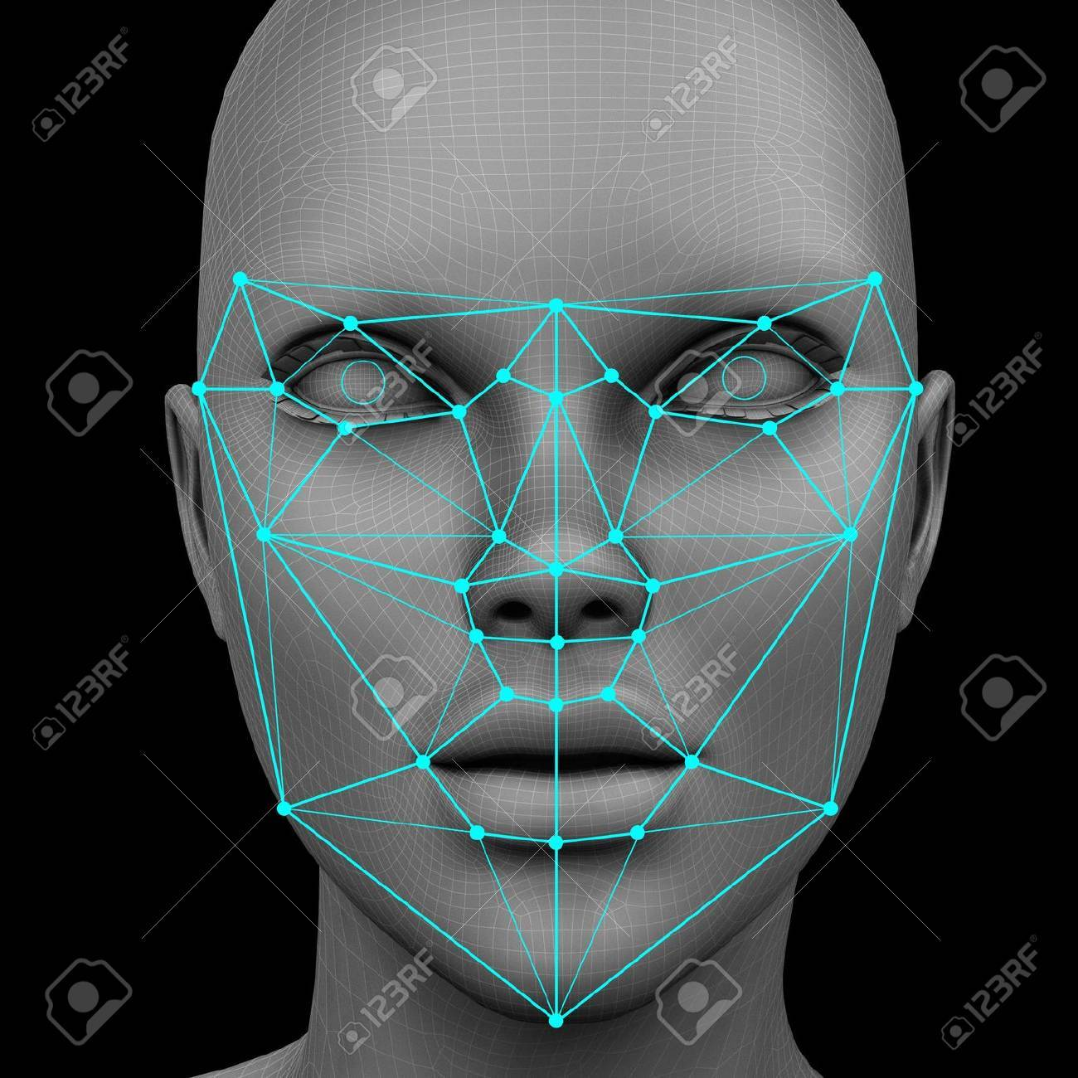
Face embeddings
By creating face embeddings you are converting a face image into numerical data. That data is then represented as a vector in a latent semantic space. The closer the embeddings are to each other in the latent space, the more likely they are of the same person.

Slide 7
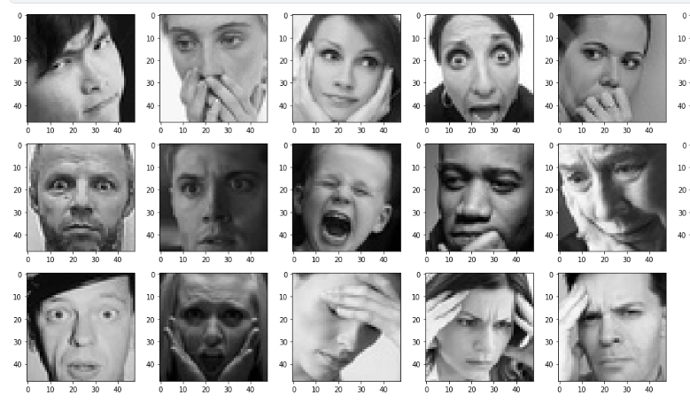
Exploratory data analysis
Plotting the Fear Faces in Training Dataset

Slide 8
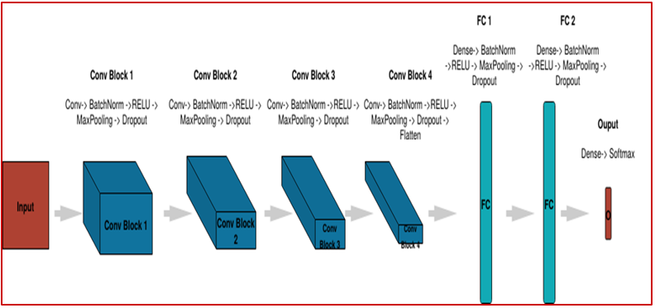
Model Building
Convolution Neural Network

Slide 9
Hyper tuning parameters
Batch Size : It refers to the number of training examples utilized in one iteration. higher batch sizes leads to lower asymptotic test accuracy
#Batch size = 128
Learning rate in Adam : the learning rate is a tuning parameter in an optimization algorithm that determines the step size at each iteration while moving toward a minimum of a loss function.
# Learning rate=0.0001
Epochs : In terms of artificial neural networks, an epoch refers to one cycle through the full training dataset
#Epochs = 150
By doing these tuning and with the help of GPU our validation accuracy improved to 4%

Slide 10
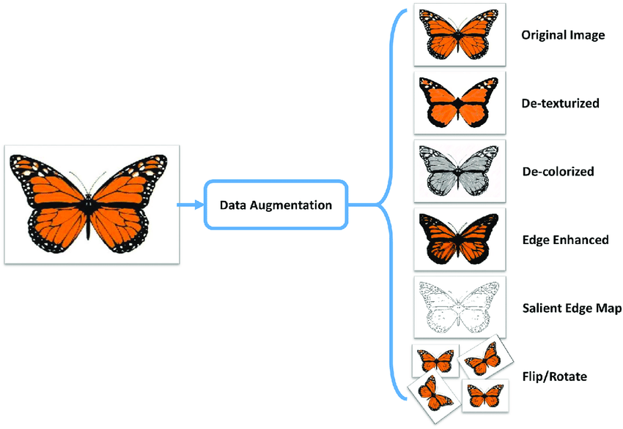
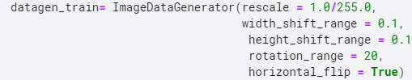
Data Augmentation
Data augmentation is a technique to artificially create new training data from existing training data. This is done by applying domain-specific techniques to examples from the training data that create new and different training examples

Slide 11
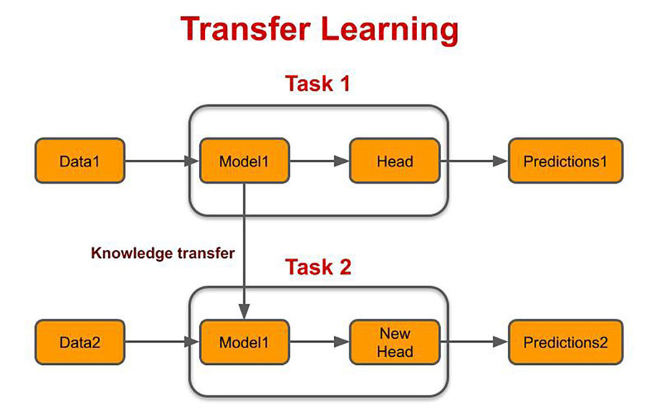
Model Building
Transfer learning is a technique whereby a neural network model is first trained on a problem similar to the problem that is being solved.
Example take a model trained on a large dataset and transfer its knowledge to a smaller dataset
We used MobileNet as transfer learning technique which is the state of the art model and It gave us accuracy about 78%.

Slide 12
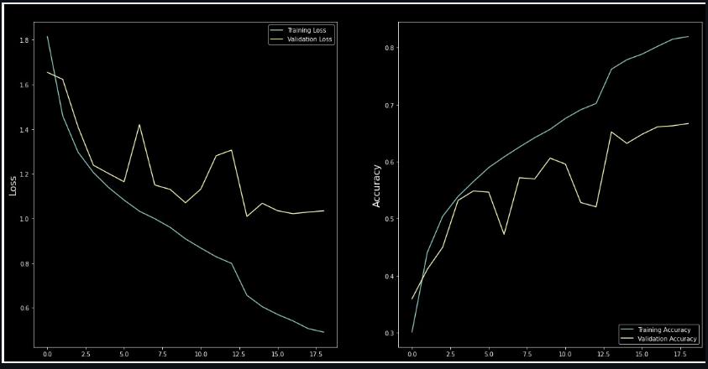
Loss and Accuracy plot

Slide 13
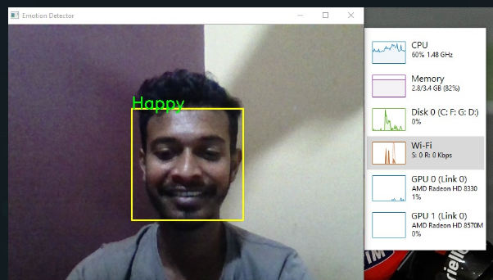
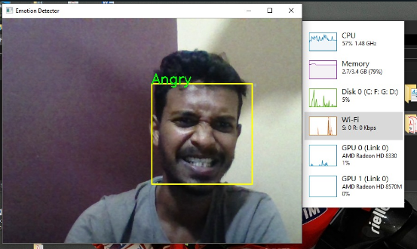
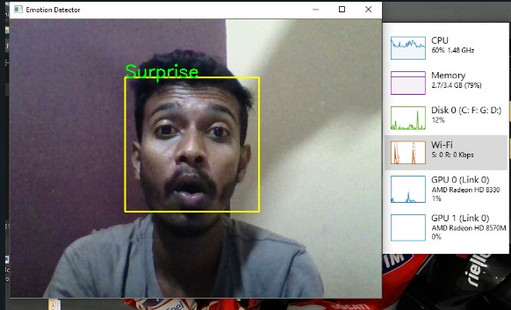
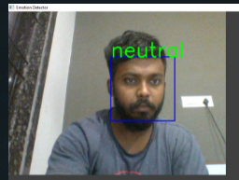
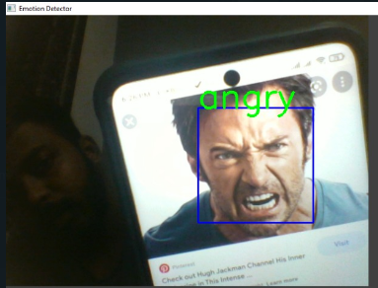
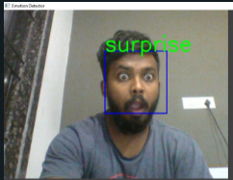
Accuracy
Test results of Open-CV in local machine

Slide 14
Deployment
We created two patterns for detecting and predicting single faces and as well as multiple faces using OpenCV video capture in local machine
We deployed in streamlit web app :
https://share.streamlit.io/shafilahamed/capstone-5--real-time-face-emotion-recognition/main
We deployed Heroku link:
https://emotion-detection-app-cnn.herokuapp.com/

Slide 15
Challenges Faced
Choosing the dataset was difficult without Kaggle it saved most of the time.
To Run CNN models we wasted to Days to improve accuracy without GPU later we came to How much time we can save with extra GPU’s we accessed it though Kaggle Notebooks.
Tuning for the best weights was also a challenge initially default values got around 65% accuracy later we improved by increase to epochs to 150, batch size = 128, using Adaptive learning rate optimization algorithm =0.0001.
Continuous Runtime and RAM Crash due to large dataset.
GCP, AWS and Azure could platforms were not able to deploy due to credit card details requirement, instead we did in Heroku.

Slide 16
Summary
We used CNN sequential model with 4 Convolution Layers with relu as activation function and 2 Fully connected layers passed through softmax function
We initially got a validation accuracy around 64% with batch size 64, and epochs 50.
By Hyper tunning the model to 128 batch size, Epochs =150 with Adaptive learning rate = 0.0001 reach validation accuracy of 69% at 138 Epoch
We run the best model weights h5 file to OpenCV it worked with all 7 emotions.
Transfer learning has best accuracy over 78%
We deployed this model on Heroku cloud platform where slug size was around 450MB, which successfully deployed and app is facing issue in boot time.
We also deployed in streamlit webapp which worked fine

Slide 17


Q&A
https://slides.app.goo.gl/Pm6VL

Slide 18


